Slide 1

Algorithms and Data Structures 2 CS 1501
Spring 2022
Sherif Khattab
ksm73@pitt.edu
(Slides are adapted from Dr. Ramirez’s and Dr. Farnan’s CS1501 slides.)

Slide 2
Announcements
Upcoming deadlines:
Lab 10 due on 4/8
Homework 11 due on 4/11
Assignment 3 and 4 due on 4/18
Used to be one assignment

Slide 3
Previous lecture …
Network Bottleneck Finding Problem
Ford-Fulkerson Max-Flow Framework
augmenting path
backwards edges
Edmonds-Karp algorithm
using BFS to find augmenting paths

Slide 4
CourseMIRROR Reflections (most confusing)
why is the max of the back edge the numerator of the forward edge?
How/why we are able to take the backwards paths whenever the graph was originally directed
Can any path from s to t be an augmenting path?
How are bottlenecks defined? Are they flow edges that saturate early?
Dijkstra algorithm but I will go over it by using past lectures
Flow was mostly clear but doing another example would be helpful
I was confused about how the runtime is calculated and what role maximum flow plays in it
Going over backwards paths one more time and showing how they reroute the existing data flow would be helpful
Edmonds Karp was most confusing.
the ford example with 2000 iterations was confusing

Slide 5
CourseMIRROR Reflections (most interesting)
How the max flow value is directly involved in the runtime of Ford-Fulkerson
djikstras algorithm for shortest path explanation
The data flow problem
Residual graph
The concept of using back edges
Optimizing max flow through use of back edges
adding backwards edges
How backwards edges can help correct mistakes
I found it interesting how BFS can help find any augmenting path
The bottleneck problem in general was most interesting.
ford fulkerson

Slide 6
Problem of the Day: Finding Network Bottlenecks
Let’s assume that we want to send a large file from point A to point B over a computer network as fast as possible over multiple network links if needed
Input:
A computer network
Network nodes and links
Links are labeled by link capacity in Mbps
Starting node and destination node
Output:
The maximum network speed possible for sending a file from source to destination

Slide 7
But our flow graph is weighted...
Edmonds-Karp only uses BFS
Used to find spanning trees and shortest paths for unweighted graphs
Why do we not use some measure of priority to find augmenting paths?
Notes:
We could…
Book discusses a modified version of Dijkstra's
Advantages?
Disadvantages?
Which is the best?
Currently unknown, but Edmonds-Karp is pg

Slide 8
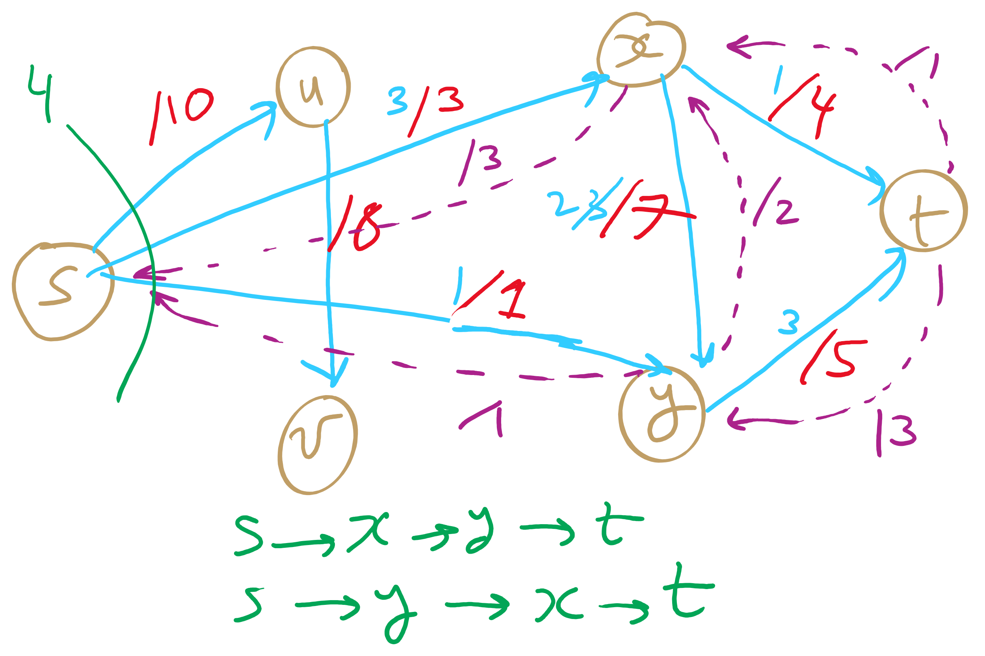
PFS Example 1

Slide 9
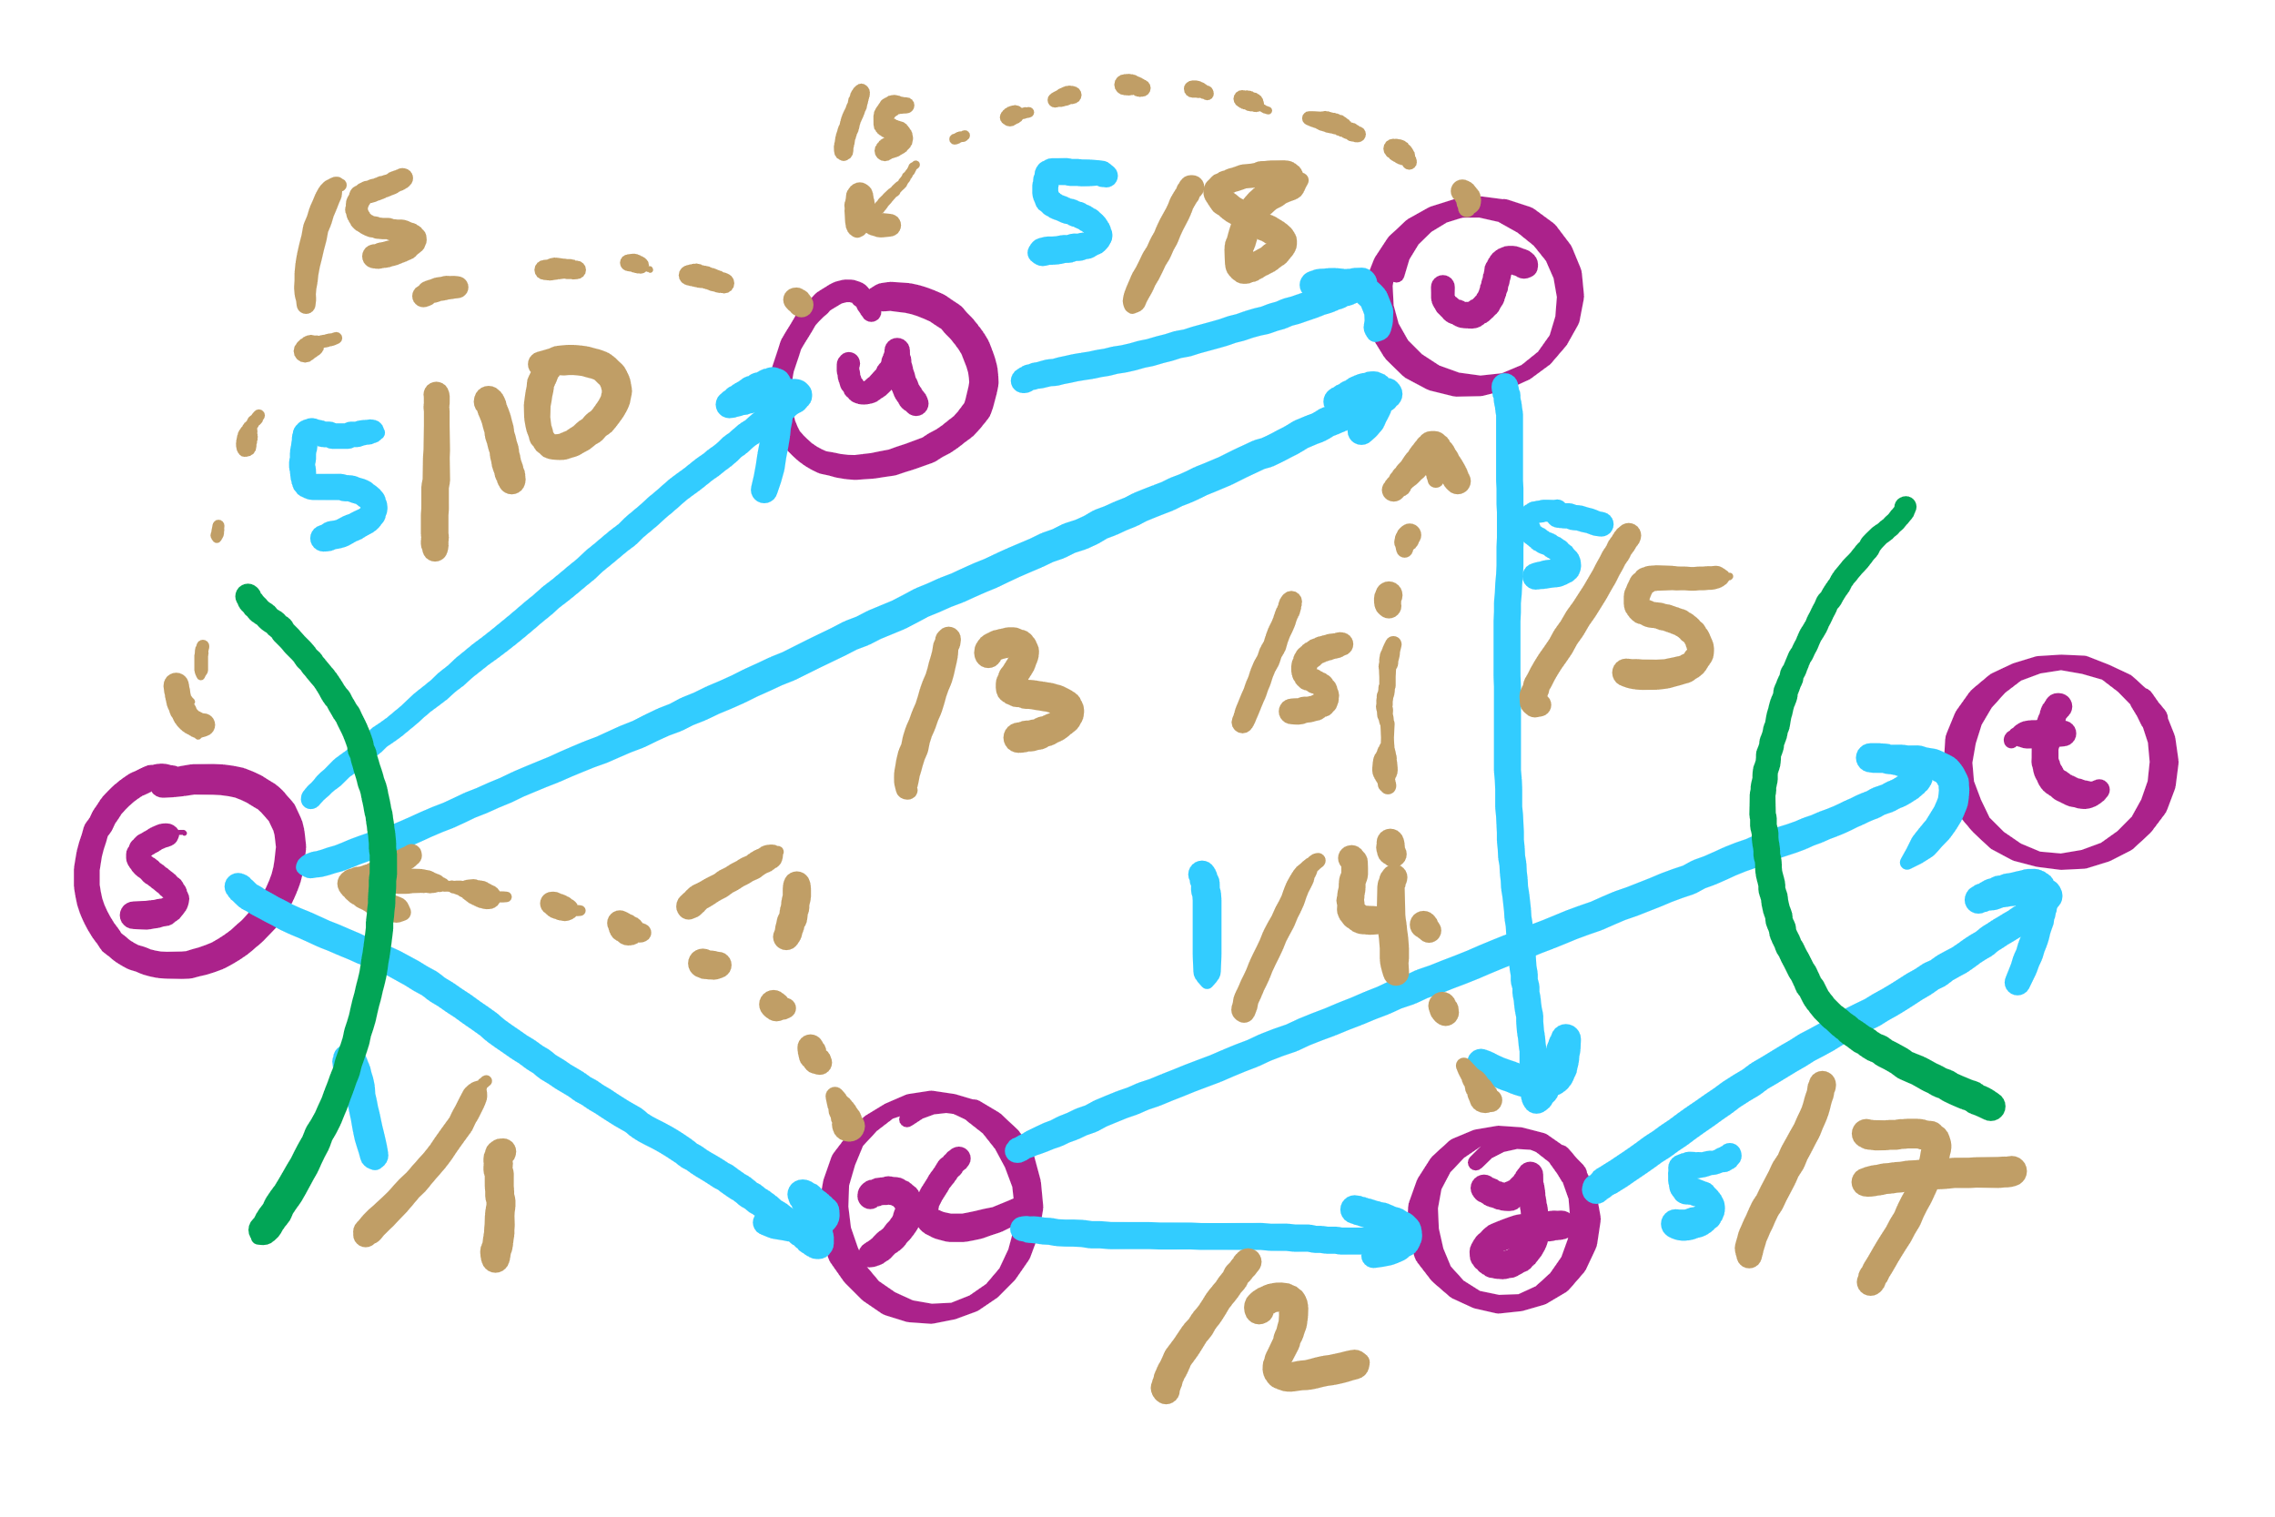
PFS Example 2

Slide 10
Flow edge implementation
For each edge, we need to store:
Start point, the from vertex
End point, the to vertex
Capacity
Flow
Residual capacities
For forwards and backwards edges

Slide 11
FlowEdge.java
public class FlowEdge {
private final int v; // from
private final int w; // to
private final double capacity; // capacity
private double flow; // flow
…
public double residualCapacityTo(int vertex) {
if (vertex == v) return flow;
else if (vertex == w) return capacity - flow;
else throw new
IllegalArgumentException("Illegal endpoint");
}
…
}

Slide 12
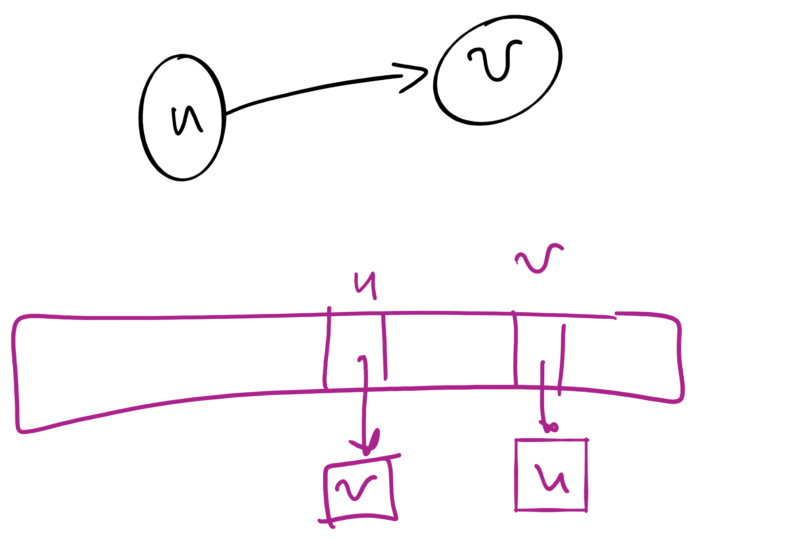
BFS search for an augmenting path (pseudocode)
edgeTo = [|V|]
marked = [|V|]
Queue q
q.enqueue(s)
marked[s] = true
while !q.isEmpty():
v = q.dequeue()
for each (v, w) in AdjList[v]:
if residualCapacity(v, w) > 0:
if !marked[w]:
edgeTo[w] = v;
marked[w] = true;
q.enqueue(w);
Each FlowEdge object is stored in the adjacency list twice:
Once for its forward edge
Once for its backward edge

Slide 13
Value of maxflow
Add up the flow increments in each iteration of Ford-Fulkerson
Add up the edge flows out of source
Add up the edge flows of the out of source

Slide 14
Follow-up Problem
So, now we found the bottleneck value, but which edges define the found bottleneck?
Why would you want to know those bottleneck edges?

Slide 15
Let's separate the graph
An st-cut on G is a set of edges in G that, if removed, will partition the vertices of G into two disjoint sets
One contains s
One contains t
May be many st-cuts for a given graph
Let’s focus on finding the minimum st-cut
The st-cut with the smallest capacity
May not be unique

Slide 16
How do we find the min st-cut?
We could examine residual graphs
Specifically, try and allocate flow in the graph until we get to a residual graph with no existing augmenting paths
A set of saturated edges will make a minimum st-cut

Slide 17
Min cut example
A
1
/1
/3
1
3
/7
2
s
C
t
2
/5
5
/7
3
3
/9
B
Notes:
Will the max flow always be the edges going into or out of the source/sink?
No! get the students to imagine a graph where this is the case

Slide 18
Max flow == min cut
A special case of duality
I.e., you can look at an optimization problem from two angles
In this case to find the maximum flow or minimum cut
In general, dual problems do not have to have equal solutions
The differences in solutions to the two ways of looking at the problem is referred to as the duality gap
If the duality gap = 0, strong duality holds
Max flow/min cut uphold strong duality
If the duality gap > 0, weak duality holds

Slide 19
Determining a minimum st-cut
First, run Ford Fulkerson to produce a residual graph with no further augmenting paths
The last attempt to find an augmenting path will visit every vertex reachable from s
Edges with only one endpoint in this set comprise a minimum st-cut

Slide 20
Determining the min cut
A
A
/1
1
/3
2
3
/7
s
s
C
C
t
5
/5
/7
3
3
/9
Min Cut
B
B
Notes:
Green is the set of seen vertices reachable from s

Slide 21
Max flow / min cut on unweighted graphs
Is it possible?
How would we measure the Max flow / min cut?
What would an algorithm to solve this problem look like?

Slide 22
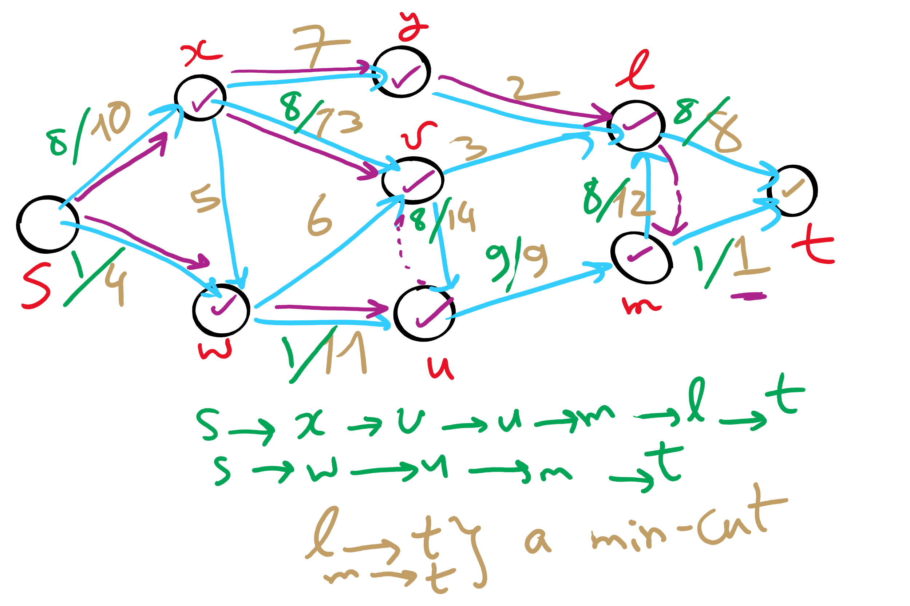
Min st-cut Example 1

Slide 23
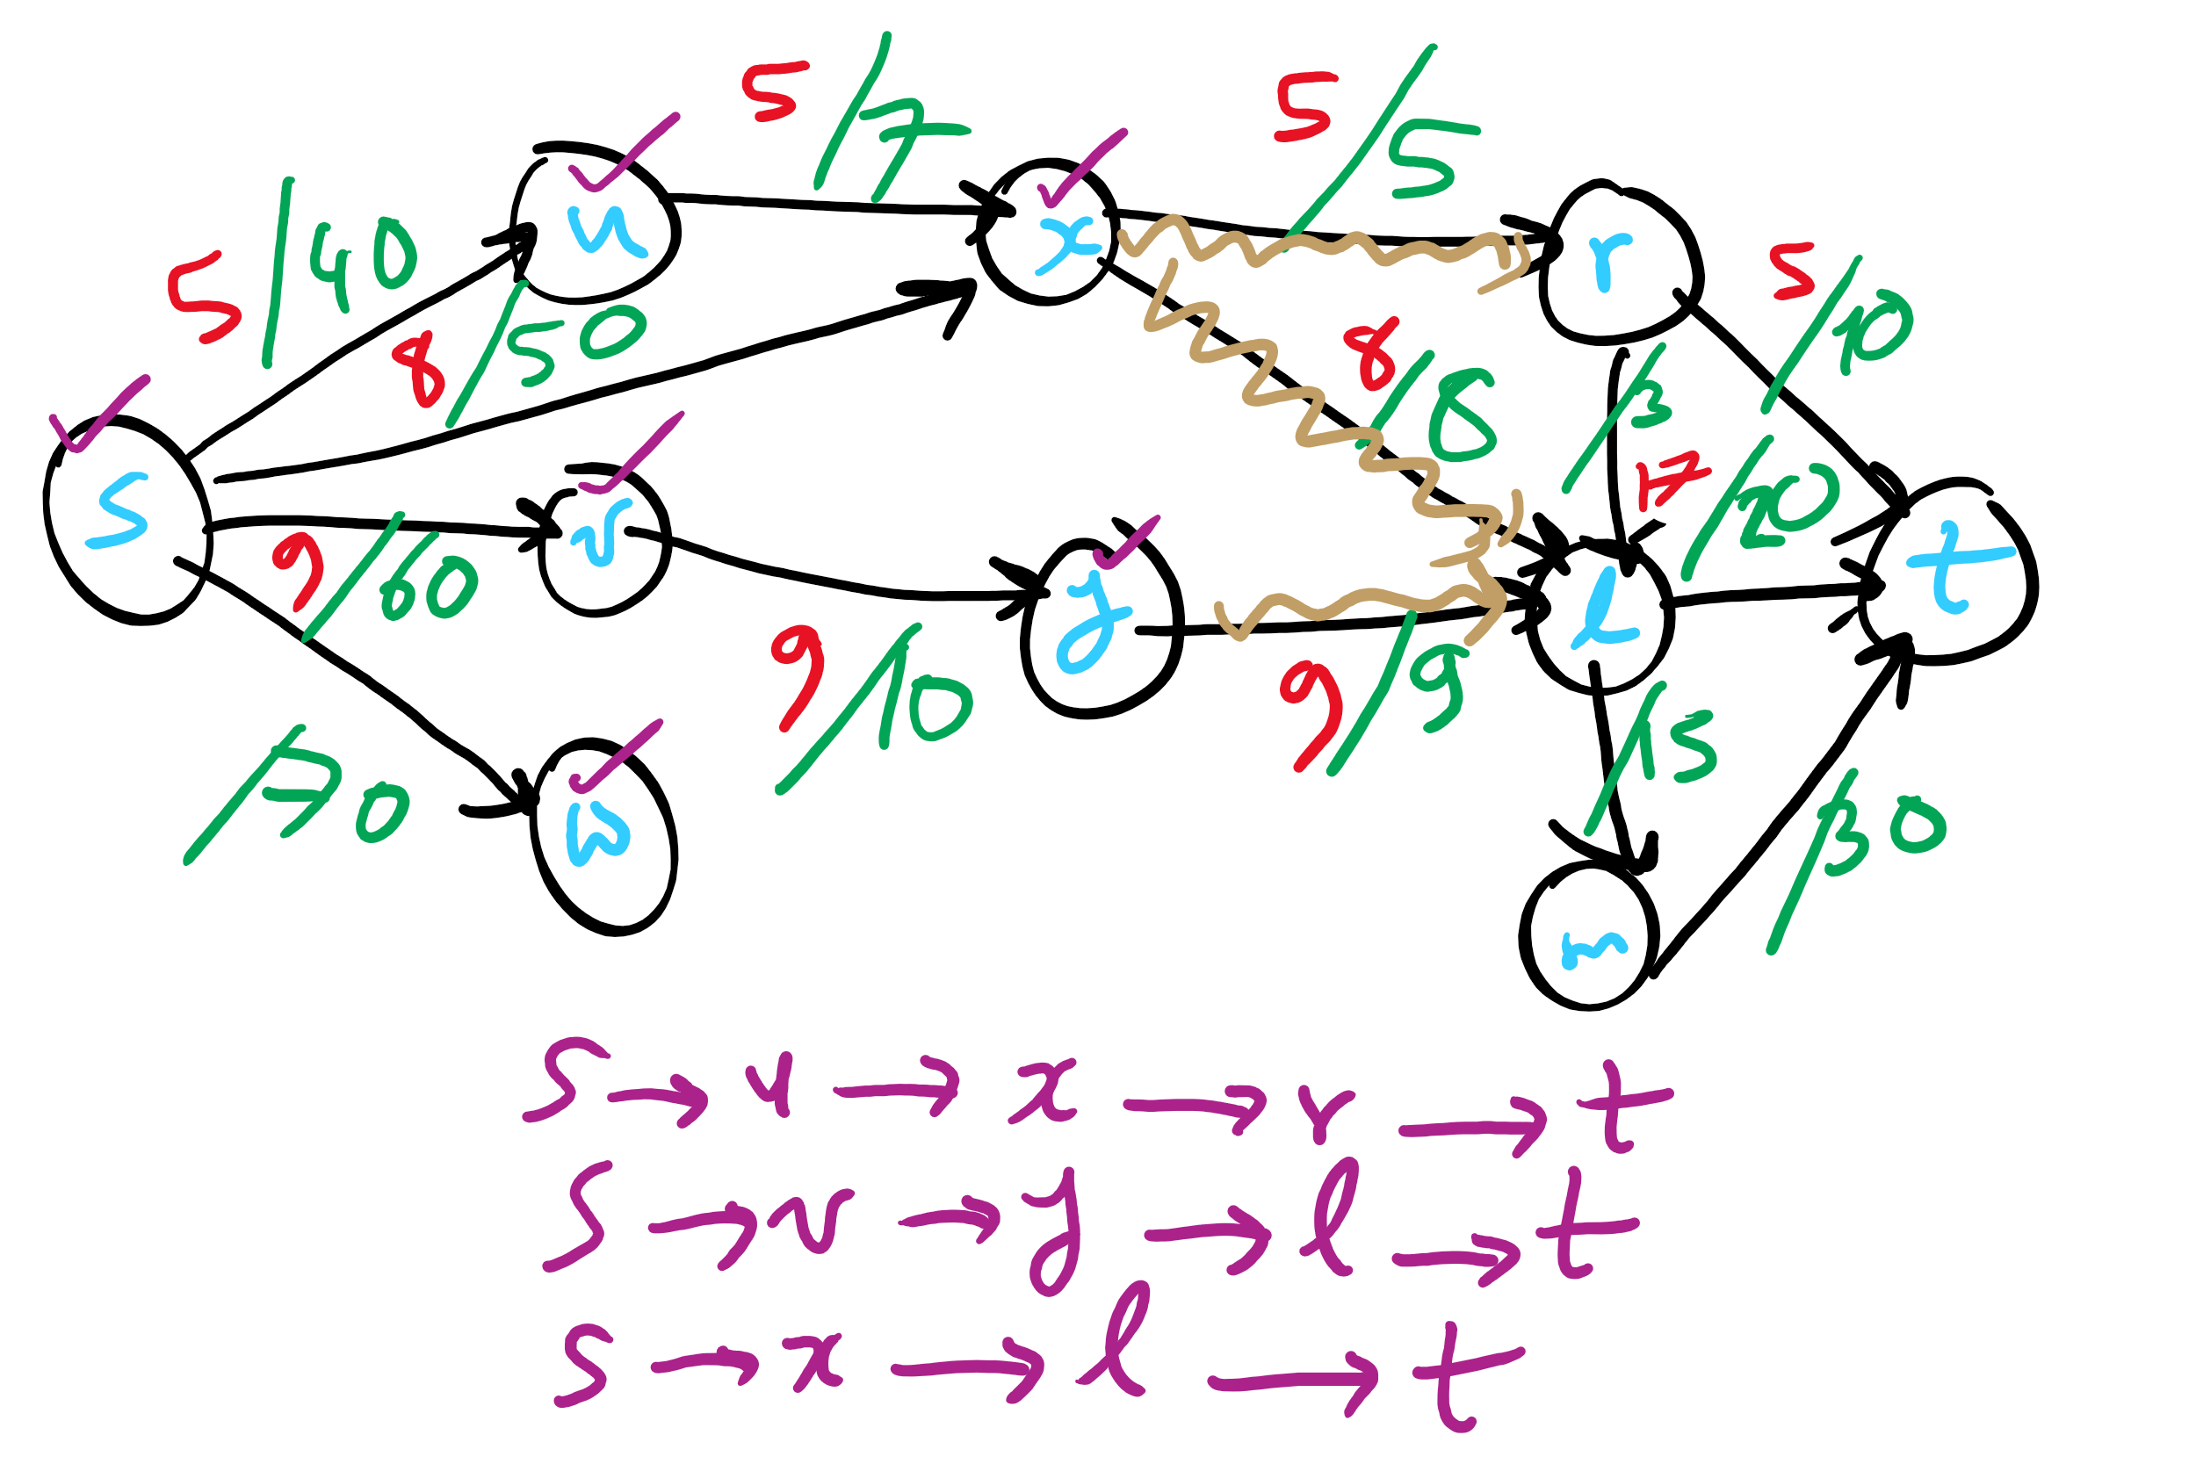
Min st-cut Example 2

Slide 24
Unweighted network flow
A
F
s
B
E
t
C
D
Notes:
Red: edge begin used in BFS pathfinding alg
Blue: edge has flow allocated to it

Slide 25
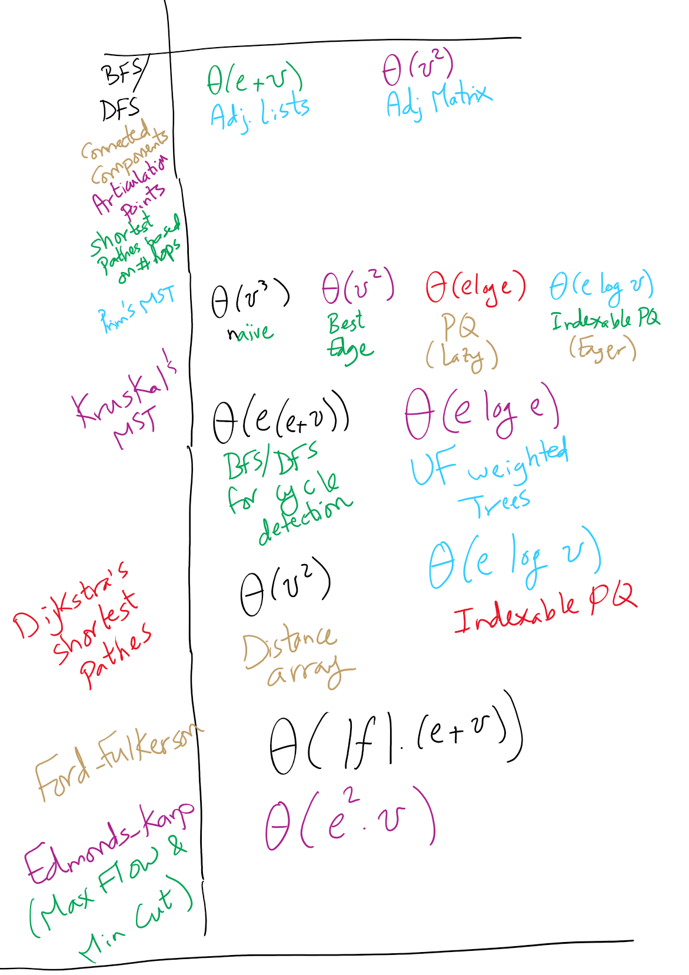
Graph Algorithms Runtime

Slide 26
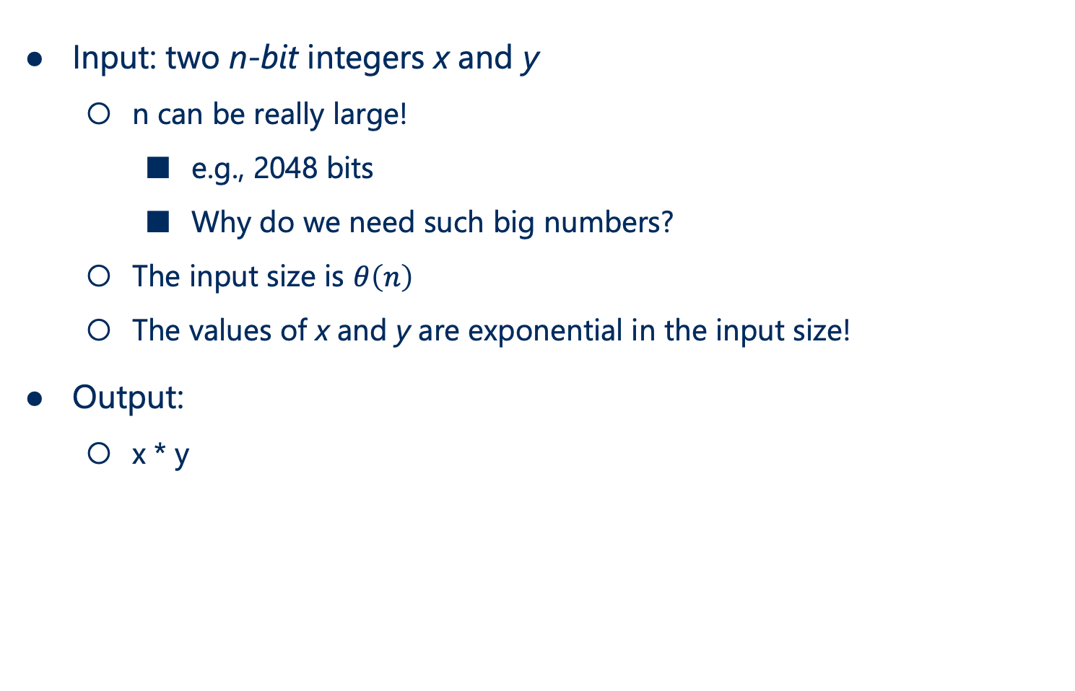
Problem of the Day: Integer multiplication
Input: two n-bit integers x and y
n can be really large!
e.g., 2048 bits
Why do we need such big numbers?
The input size is $θ\left(n\right)$
The values of x and y are exponential in the input size!
Output:
x * y

Slide 27
Yeah, but the processor has a MUL instruction
Assuming x86
Given two 32-bit integers, MUL will produce a 64-bit integer in a few cycles
What about when we need to multiply large ints?
VERY large ints?
RSA keys should be 2048 bits
Back to grade school…

Slide 28
Gradeschool algorithm on binary numbers
10100000100
x 11000101111
10100000100
101000001000
1010000010000
10100000100000
000000000000000
1010000010000000
00000000000000000
000000000000000000
0000000000000000000
10100000100000000000
101000001000000000000
111110000001110111100

Slide 29
OK, I’m guessing we all knew that...
What is the runtime of this multiplication algorithm?
For 2 n-digit numbers:
n²
Notes:
What is the size of our input?
Note that as stated this is also n² space, but need not be

Slide 30
How can we improve our runtime?
Let’s try to divide and conquer:
Break our n-bit integers in half:
x = 1001011011001000, n = 16
Let the high-order bits be x_{H} = 10010110
Let the low-order bits be x_{L} = 11001000
x = 2^{n/2}x_{H} + x_{L}
Do the same for y
x * y = (2^{n/2}x_{H} + x_{L}) * (2^{n/2}y_{H} + y_{L})
x * y = 2^{n}x_{H}y_{H} + 2^{n/2}(x_{H}y_{L} + x_{L}y_{H}) + x_{L}y_{L}

Slide 31
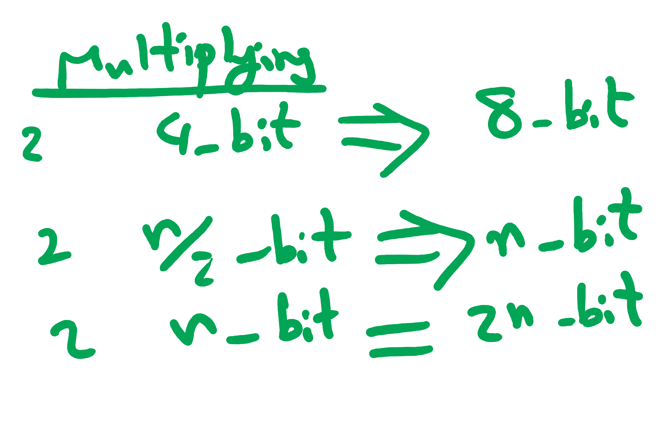
So what does this mean?
4 multiplications of n/2 bit integers
3 additions of n-bit integers
2^{n}x_{H}y_{H} + 2^{n/2}(x_{H}y_{L} + x_{L}y_{H}) + x_{L}y_{L}
A couple shifts of up to n positions
Actually 16 multiplications of n/4 bit integers
(plus additions/shifts)
Actually 64 multiplications of n/8 bit integers
(plus additions/shifts)
...

Slide 32
Karatsuba’s algorithm
By reducing the number of recursive calls (subproblems), we can improve the runtime
x * y = 2^{n}x_{H}y_{H} + 2^{n/2}(x_{H}y_{L} + x_{L}y_{H}) + x_{L}y_{L}
M1
M2
M3
M4
We don’t actually need to do both M2 and M3
We just need the sum of M2 and M3
If we can find this sum using only 1 multiplication, we decrease the number of recursive calls and hence improve our runtime

Slide 33
Karatsuba craziness
M1 = x_{h}y_{h}; M2 = x_{h}y_{l}; M3 = x_{l}y_{h}; M4 = x_{l}y_{l};
The sum of all of them can be expressed as a single mult:
M1 + M2 + M3 + M4
= x_{h}y_{h} + x_{h}y_{l} + x_{l}y_{h} + x_{l}y_{l}
= (x_{h} + x_{l}) * (y_{h} + y_{l})
Lets call this single multiplication M5:
M5 = (x_{h} + x_{l}) * (y_{h} + y_{l}) = M1 + M2 + M3 + M4
Hence, M5 - M1 - M4 = M2 + M3
So: x * y = 2^{n}M1 + 2^{n/2}(M5 - M1 - M4) + M4
Only 3 multiplications required!
At the cost of 2 more additions, and 2 subtractions

Slide 34
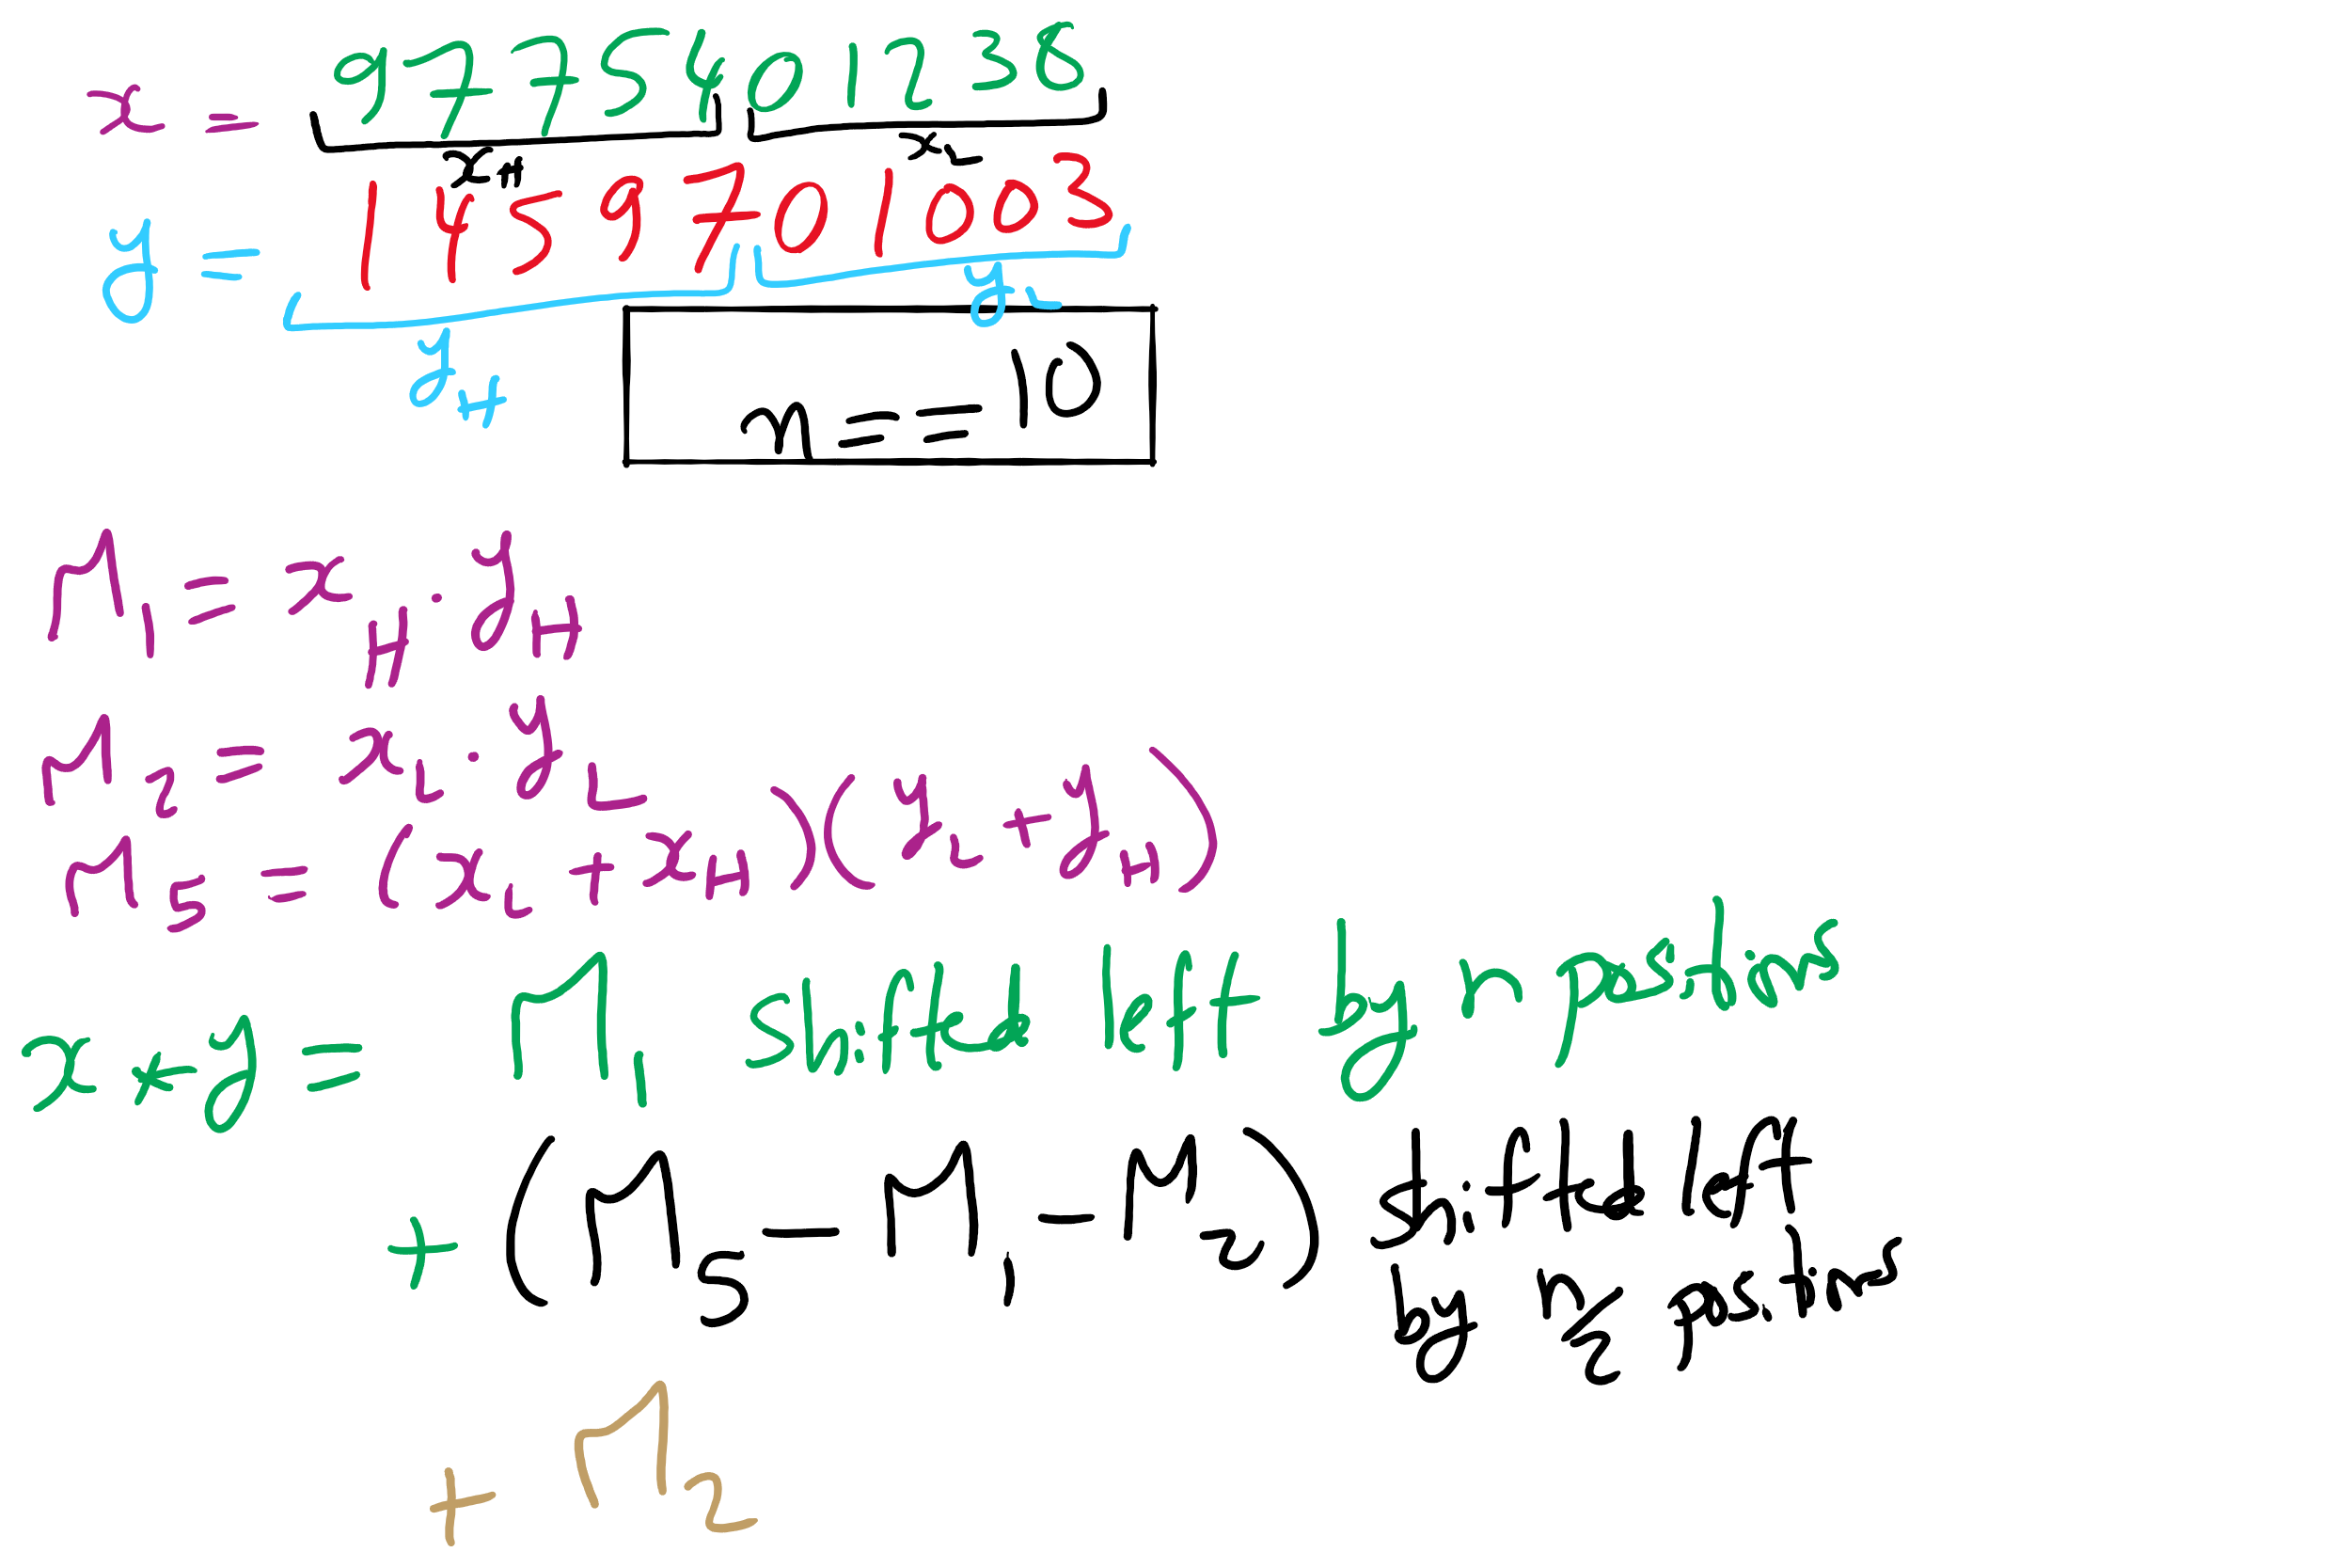
Karatsuba Example

Slide 35
Large integer multiplication in practice
Can use a hybrid algorithm of grade school for large operands, Karatsuba’s algorithm for VERY large operands
Why are we still bothering with grade school at all?
Notes:
Practical penalties of extra additions/subtractions
estimates say 320-640 bits is the tipping point for karatsubas

Slide 36
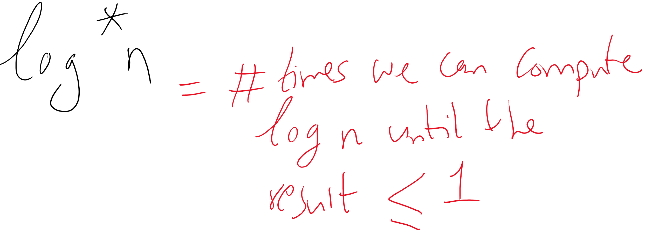
Is this the best we can do?
The Schönhage–Strassen algorithm
Uses Fast Fourier transforms to achieve better asymptotic runtime
O(n log n log log n)
Fastest asymptotic runtime known from 1971-2007
Required n to be astronomical to achieve practical improvements to runtime
Numbers beyond 2^{2^15} to 2^{2^17}
Fürer was able to achieve even better asymptotic runtime in 2007
n log n 2^{O(log^* n)}
No practical difference for realistic values of n
Notes:
The GNU Multi-Precision Library uses Schönhage–Strassen for 1728 to 7808 64-bit words
BigInteger will look over gradeschool, karatsuba, and toom3 (toom-cook variant)
There is a Java implementation of Schönhage–Strassen which uses it above 74,000 decimal digits

Slide 37
Exponentiation
x^{y}
Can easily compute with a simple algorithm:
ans = 1
i = y
while i > 0:
ans = ans * x
i--
Runtime?
Notes:
looking for θ(y) or "linear"

Slide 38
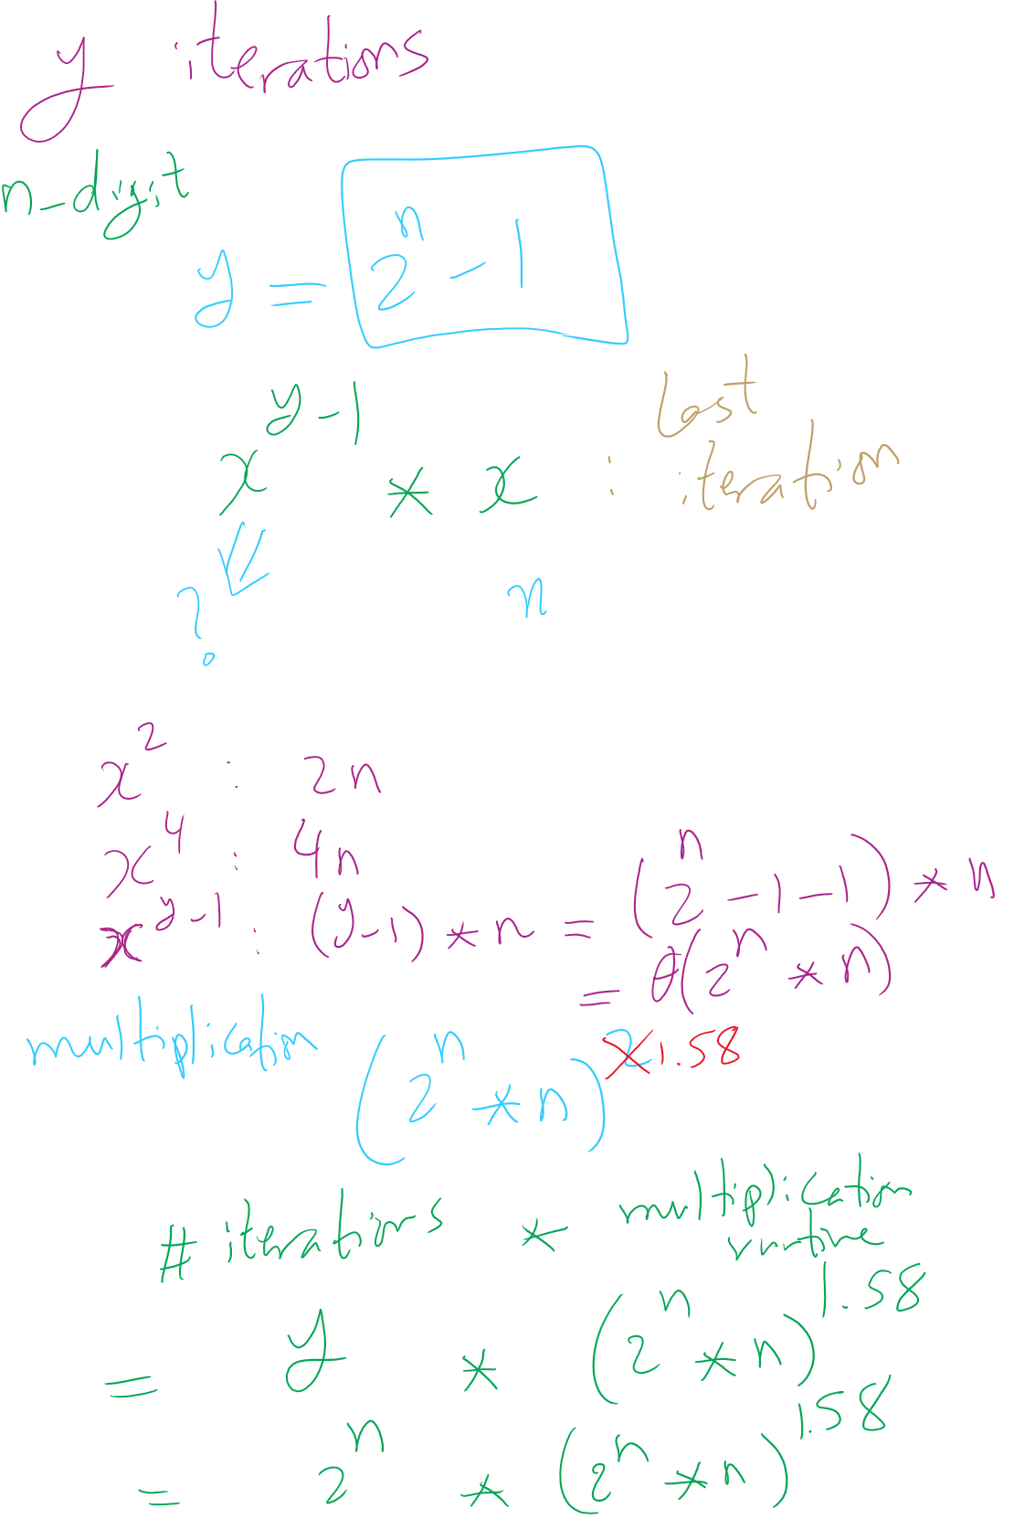
Runtime Analysis

Slide 39
Just like with multiplication, let's consider large integers...
Runtime = # of iterations * cost to multiply
So how many iterations?
Single loop from 1 to y, so linear, right?
What is the size of our input?
n
The bitlength of y…
So, linear in the value of y…
But, increasing n by 1 doubles the number of iterations
Θ(2^{n})
Exponential in the bitlength of y
Notes:
What is the size of our input?
Cost to multiple using gradeschool: n^2

Slide 40
This is RIDICULOUSLY BAD
Assuming 512 bit operands, 2⁵¹²:
13407807929942597099574024998205846127479365820592393377723561443721764030073546976801874298166903427690031858186486050853753882811946569946433649006084096
Assuming we can do mults in 1 cycle…
Which we can’t as we learned last lecture
And further that these operations are completely parallelizable
16 4GHz cores = 64,000,000,000 cycles/second
(2⁵¹² / 64000000000) / (3600 * 24 * 365) =
6.64 * 10¹³⁵ years to compute

Slide 41
This is way too long to do exponentiations!
So how do we do better?
Let’s try divide and conquer!
x^{y} = (x^{(y/2)})²
When y is even, (x^{(y/2)})² * x when y is odd
Analyzing a recursive approach:
Base case?
When y is 1, x^{y} is x; when y is 0, x^{y} is 1
Runtime?

Slide 42
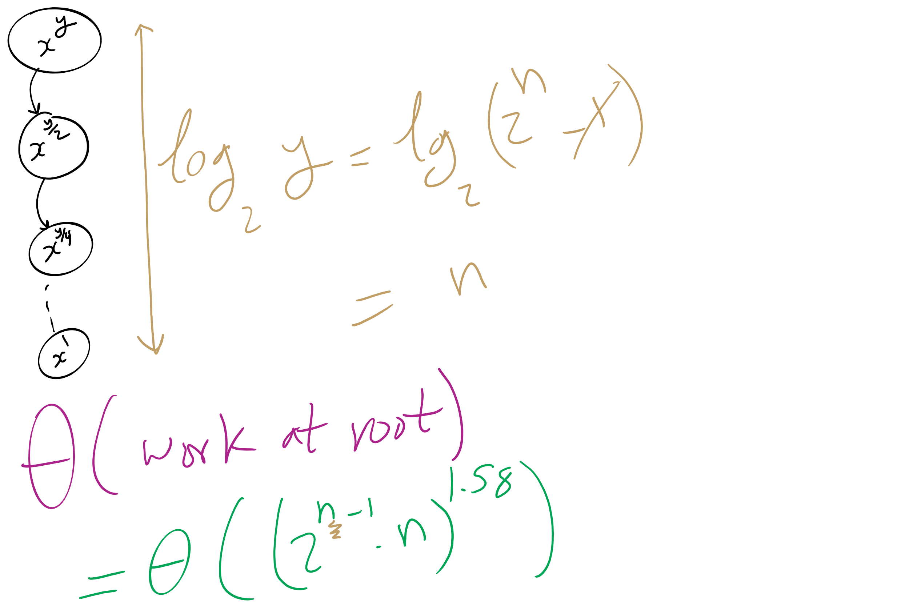
Runtime Analysis

Slide 43
But we need to do expensive mult in each call
We need to do Θ((2^{(n-1)} * n)²) work in just the root call!
Our runtime is dominated by multiplication time
Exponentiation quickly generates HUGE numbers
Time to multiply them quickly becomes impractical

Slide 44
Can we do better?
We go “top-down” in the recursive approach
Start with y
Halve y until we reach the base case
Square base case result
Continue combining until we arrive at the solution
What about a “bottom-up” approach?
Start with our base case
Operate on it until we reach a solution

Slide 45
A bottom-up approach
To calculate x^{y}
ans = 1
foreach bit in y:
ans = ans²
if bit == 1:
ans = ans * x
From most to least significant

Slide 46
Bottom-up exponentiation example
Consider x^{y} where y is 43 (computing x⁴³)
Iterate through the bits of y (43 in binary: 101011)
ans = 1
ans = 1² = 1
ans = 1 * x = x
ans = x² = x²
ans = (x²)² = x⁴
ans = x⁴ * x = x⁵
ans = (x⁵)² = x¹⁰
ans = (x¹⁰)² = x²⁰
ans = x²⁰ * x = x²¹
ans = (x²¹)² = x⁴²
ans = x⁴² * x = x⁴³
Notes:
3⁴³ = 328256967394537077627

Slide 47
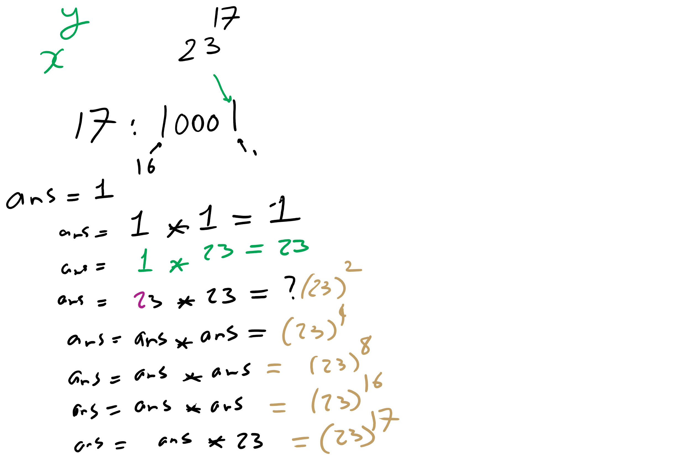
Bottom-up Exponentiation Example 1

Slide 48
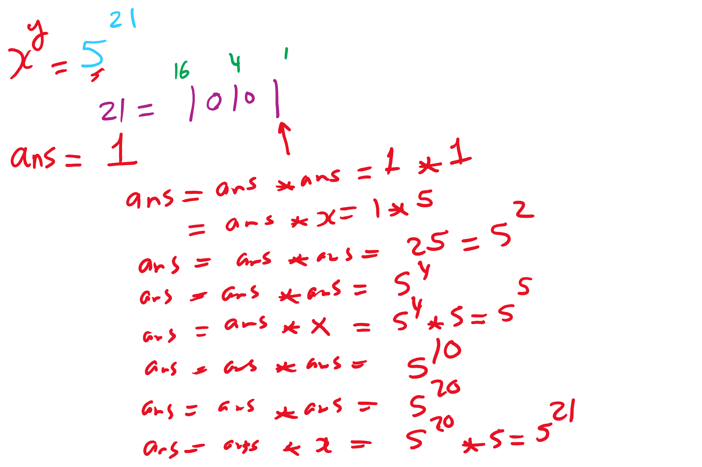
Bottom-up Exponentiation Example 2

Slide 49
Does this solve our problem with mult times?
Nope, still squaring ans everytime
We’ll have to live with huge output sizes
This does, however, save us recursive call overhead
Practical savings in runtime

Slide 50
Greatest Common Divisor
GCD(a, b)
Largest int that evenly divides both a and b
Easiest approach:
BRUTE FORCE
i = min(a, b)
while(a % i != 0 || b % i != 0):
i--
Runtime?
Θ(min(a, b))
Linear!
In value of min(a, b)...
Exponential in n
Assuming a, b are n-bit integers

Slide 51
Euclid’s algorithm
b
GCD(a, b) = GCD(b, a % b)
a % b
a
Notes:
GCD(1071, 462) = 21
If students don't believe me, tell them to make a 1071 x 462 pixel image in paint and try it out

Slide 52
Euclidean example 1
GCD(30, 24)
= GCD(24, 30 % 24)
= GCD(24, 6)
= GCD(6, 24 % 6)
= GCD(6, 0)...
Base case! Overall GCD is 6

Slide 53
Euclidean example 2
= GCD(99, 78)
99 = 78 * 1 + 21
= GCD(78, 21)
78 = 21 * 3 + 15
= GCD(21, 15)
21 = 15 * 1 + 6
= GCD (15, 6)
15 = 6 * 2 + 3
= GCD(6, 3)
6 = 3 * 2 + 0
= 3

Slide 54
Analysis of Euclid’s algorithm
Runtime?
Tricky to analyze, has been shown to be linear in n
Where, again, n is the number of bits in the input

Slide 55
Extended Euclidean algorithm
In addition to the GCD, the Extended Euclidean algorithm (XGCD) produces values x and y such that:
GCD(a, b) = i = ax + by
Examples:
GCD(30,24) = 6 = 30 * 1 + 24 * -1
GCD(99,78) = 3 = 99 * -11 + 78 * 14
Can be done in the same linear runtime!

Slide 56
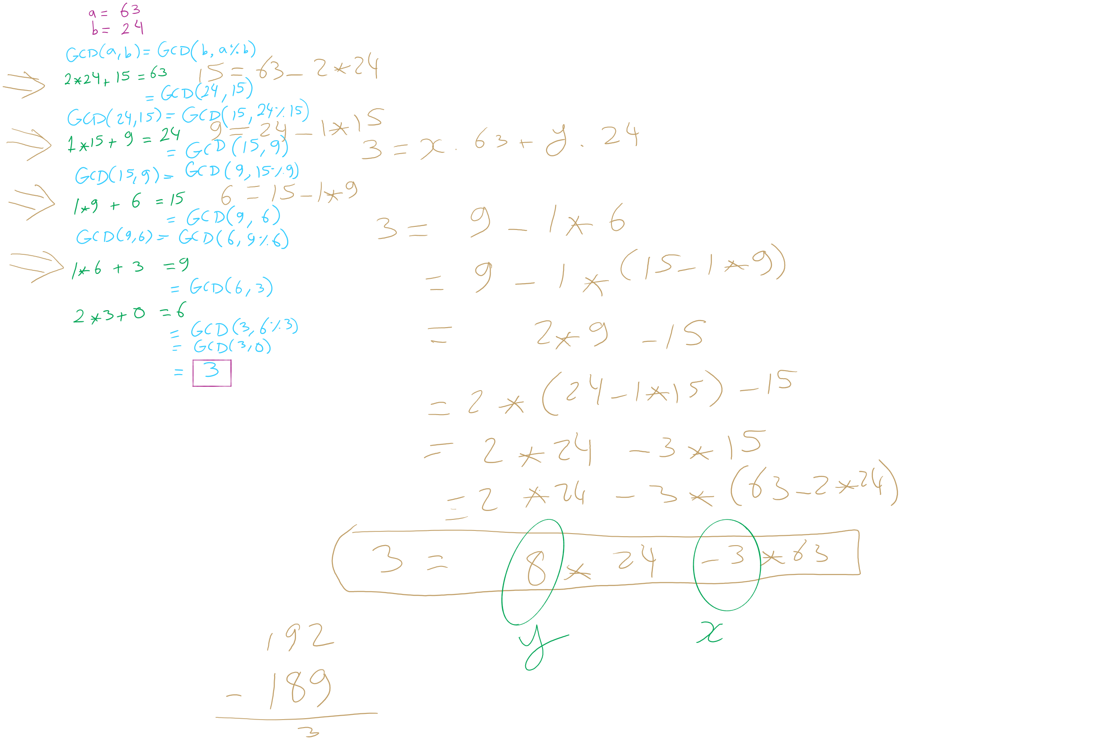
GCD/XGCD Example 1

Slide 57
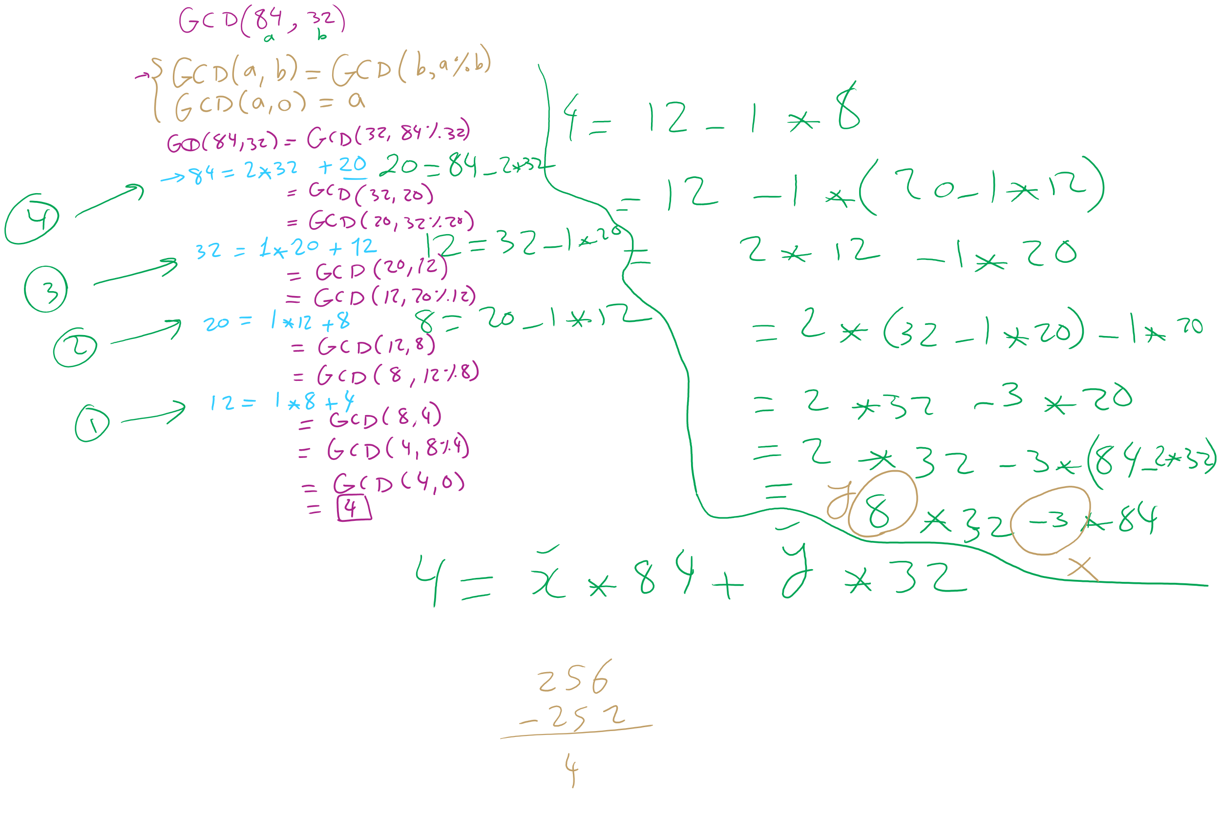
GCD/XGCD Example 2

Slide 58
Please submit your reflections by using the CourseMIRROR App
If you are having a problem with CourseMIRROR, please send an email to coursemirror.development@gmail.com
Notes:
All right!
Upcoming Due Dates at A Glance

